Slide 1
Week 2 Lab Exercise
Eddie Flores
MSDS610 – Data Engineering

Slide 2
E-commerce Business Transaction Dataset
Description:
The dataset contains 536,350 rows of sales transaction data from a retail store, capturing information about products, customers, prices, and sales dates.
Source:
Kaggle
https://www.kaggle.com/datasets/gabrielramos87/an-online-shop-business

Slide 3
Dataset Fields Description
Field Name | Type | Description | Relevance
TransactionNo | Nominal | Unique identifier for each transaction | Groups products and quantities by transaction
Date | Nominal | Date when the transaction occurred | Analyzing time trends and seasonality
ProductNo | Nominal | Unique identifier for each product | Links to product-level analysis
ProductName | Nominal | Name of the product sold | Provides context for product trends
Price | Continuous | Price of a single product unit | Crucial for revenue calculations
Quantity | Discrete | Number of units sold | Used for volume and revenue analysis
CustomerNo | Nominal | Unique identifier for each customer | Analyzes customer purchase behavior
Country | Nominal | Country where transaction occurred | Useful for geographic sales analysis

Slide 4
Optimize Product Revenue and Customer Insights
Problem Statement:
Identify the top revenue-generating products to optimize inventory and marketing strategies.
Segment customers based on purchasing behavior to design tailored promotions.
Detect seasonal trends in sales to improve forecasting accuracy.

Slide 5
Machine Learning System (MLS)
Input
Preprocessing
Collect Sales Data
Clean Data
Normalize or Scale
Feature Engineering
Model
Choose Model for Specific Problem:
Linear Regression
Output
Revenue Drivers
Customer Insights
Action
Inventory Optimization
Random Forest
Time Series
K-Means
Sales Forecast
Marketing Strategies
Strategic Planning

Slide 6
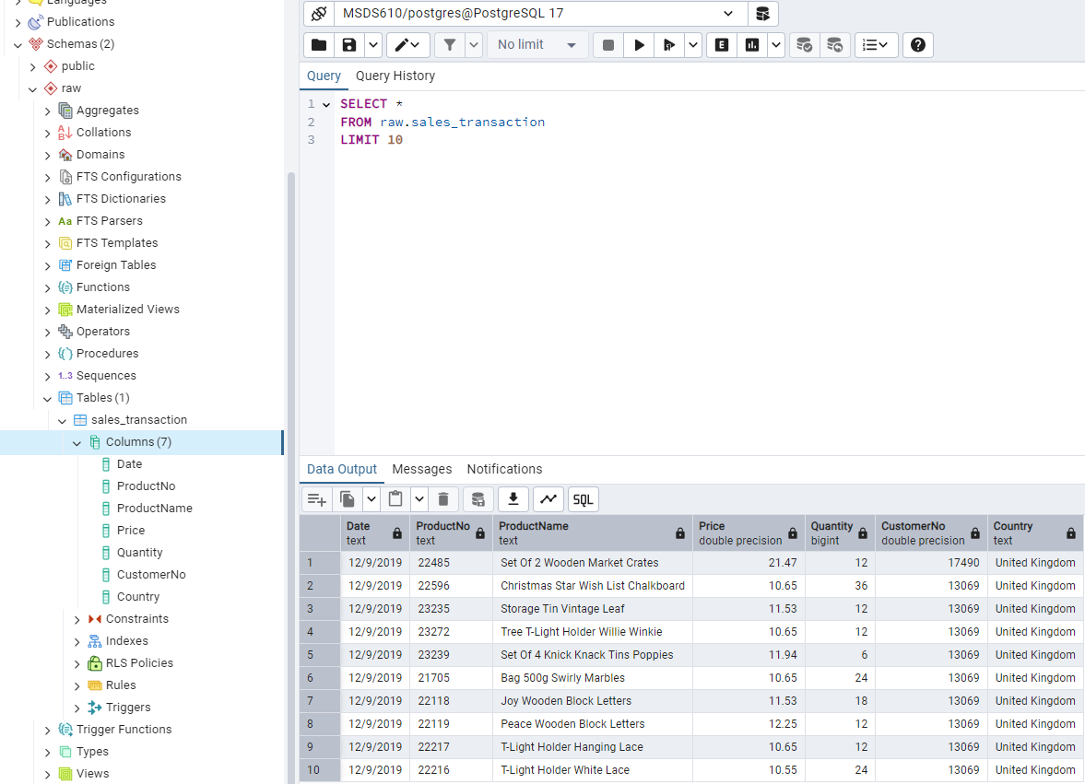
Data loaded to Postgres DB using python.

